Slide 1

Meals On Map (MOM) “Pick-up Homemade meals from your neighborhood!”
Team:
Dipti Bhosale (87114)
Sruthi Punyamurthula (87872)
Vivek Vyas (87923)
Spring 2016
SWE 690 - 4 (Prof. Mamoun Samaha)
Capstone Project

Slide 2
Agenda
2
Overview
Market Landscape
Problem Statement
Our Solution
Business Model
Risk Management
Roadmap
Architecture
Database Schema
Demo
2711 North First St. - San Jose, CA 95134 - www.itu.edu
*

Slide 3




3
Capstone project: Meals on Map (MoM)
Student 1: Name: Dipti Bhosale Student ID: 87114
Student 2: Name: Sruthi Punyamurthula Student ID: 87872
Student 3: Name: Vivek Vyas Student ID: 87923
Poor Excellent
Ability to create project plan
Design and create engineering
Implementation and execution
Testing and validation
Presentation and documentation
2711 North First St. - San Jose, CA 95134 - www.itu.edu
*

Slide 4







Overview
4
Homemade Food
Pickup or
get Delivered
Time and Location Based Search
Unique solution: Make fresh homemade food available to people in a neighborhood which is cooked by the chefs in the same neighborhood
Meals on Map
Business Opportunity for home based cooks
Rate and Review Meals
2711 North First St. - San Jose, CA 95134 - www.itu.edu
*

Slide 5
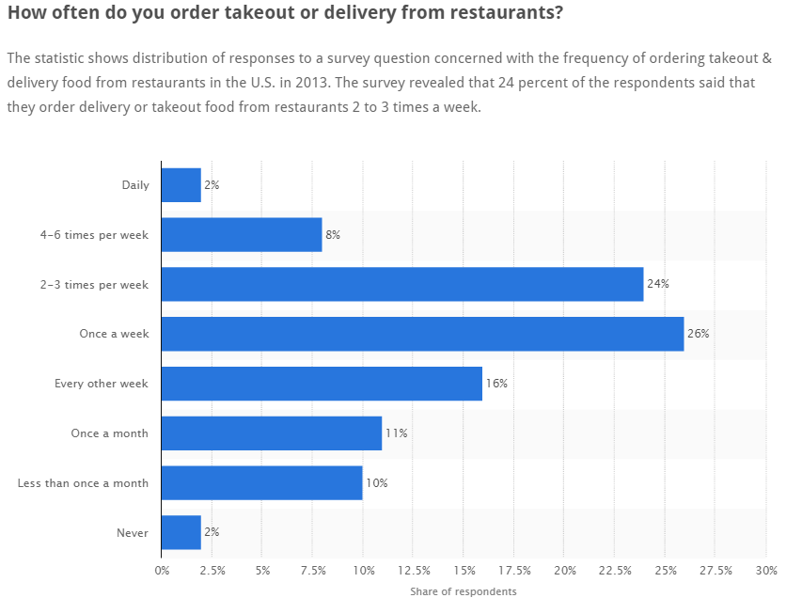
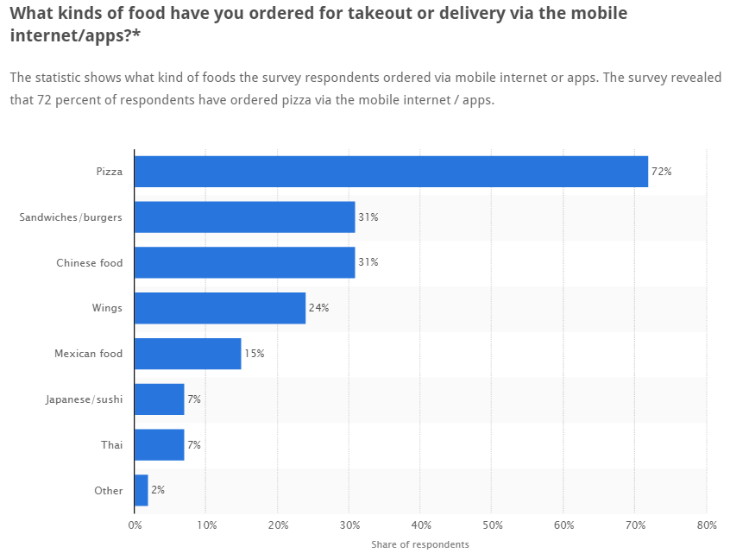
Market Landscape
5
2711 North First St. - San Jose, CA 95134 - www.itu.edu
*

Slide 6
Problem Statement
6
Homemade meals are rare for the group of customers who order meals online either for delivery or take-out.
Existing restaurant businesses are making money, by both being expensive and unhealthy.
People’s day-to-day life is busy and health is taking a toll in their schedule.
Eating habits are changing, making home cooked meals a very healthy but rare and unaffordable choice.
2711 North First St. - San Jose, CA 95134 - www.itu.edu
*

Slide 7
Our Solution
7
Helps people choose the meals that they like from the area near them.
Partner with home based cooks who have a platform to exhibit their work and also make money on a small scale.
Provide them a small customer base if they want to expand the business in future.
Providing an online platform for users who are dependent on ordering meals most part of their week.
2711 North First St. - San Jose, CA 95134 - www.itu.edu
*

Slide 8
Business Model
8
Focus is on homebased cooks and customers who prefer healthy homemade food.
Using technology to connect health, variety and affordability.
Create a platform which will expand the possibilities of having healthy, preferred food, near your locality.
Providers will use our solution to explore their customer base and get reviews about their cooking.
Customers will use the application to connect to cooks allowing them to order food that they wish, homemade and also customized according to their preferences.
Our Meals On Map team will develop, host, and market the solution; perform data analytics; perform quality control and provide user satisfaction.
Meals On Map… providing homemade meals in your neighborhood.
2711 North First St. - San Jose, CA 95134 - www.itu.edu
*

Slide 9
Risk Management
Market Competition Risk : East to penetrate in market.
Data Risk : Security of data is crucial to the company reputation.
Continuous deliverables : Over a period of time, company has to keep on delivering product updates to sustain.
Market Share Risk : Since the market size is hard to predict.
Product Break through Risk : When will we achieve the product break even point.

Slide 10
Risk Management (Cont.)
Risk Identification
Gathering Information
SWOT Analysis
Risk Analysis
Qualitative
Quantitative
Risk Response
Preventive/Mitigative Actions
Acceptance
Risk Management
Track/Control Risk
Risk Level Analysis

Slide 11
Roadmap
Key Areas | Ideation Phase | Validation Phase | Customer Growth Phase
Platform | Web Application | IOS/Android | Mobile/Web
Front-End | Prototype: HTML/CSS/Java Script | Bootstrap, Native/Hybrid | Enhance UI
Backend | MySQL | MySQL
Database | MySQL | MySQL
API | Google Maps API / REST API (Phase done) | Platform API’s
Payment | PayPal/ Google Wallet/Gift Cards | Apple Pay/ Google Pay
Security | Simple Authentication | OAuth
08/2016
12/2016
05/2017

Slide 12
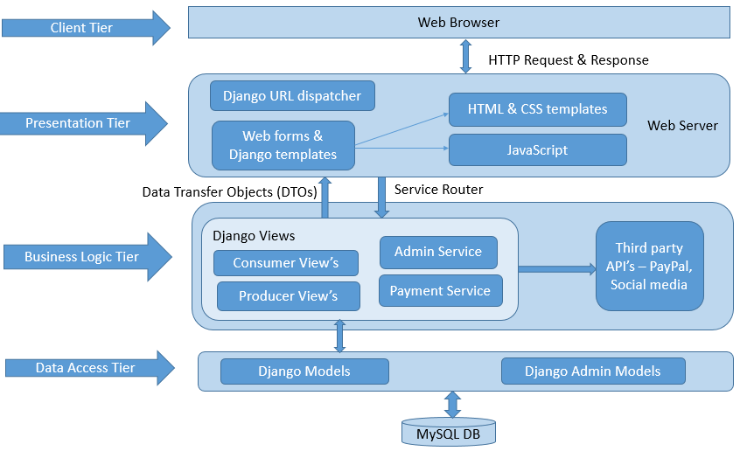
4-tier Architecture

Slide 13
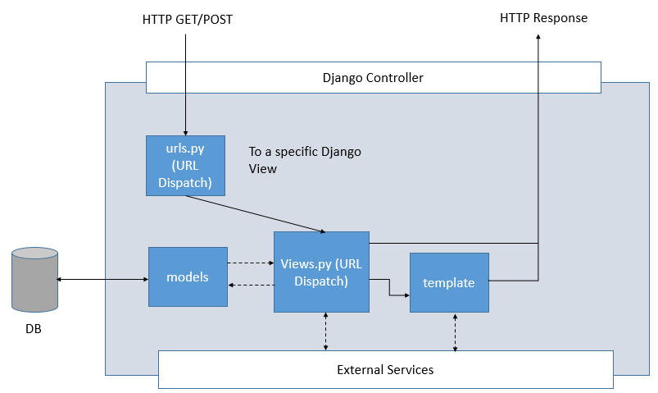
Software Architecture
13
2711 North First St. - San Jose, CA 95134 - www.itu.edu
*

Slide 14
Django as an MVC Design Pattern
14
MVC Architecture:
Models : Describes your database schema
Views : Controls what a user sees
Templates : How a user sees it
Controller : The Django Framework URL dispatcher
2711 North First St. - San Jose, CA 95134 - www.itu.edu
*

Slide 15
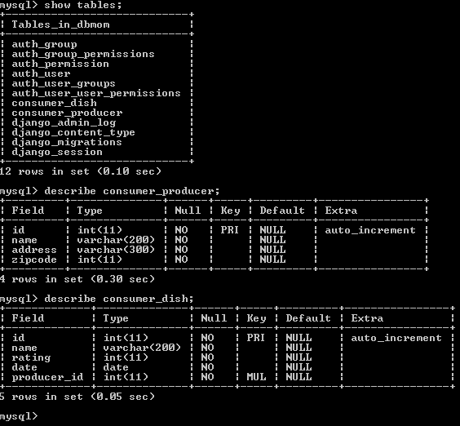
Code Screenshots - Database
15
2711 North First St. - San Jose, CA 95134 - www.itu.edu
*

Slide 16
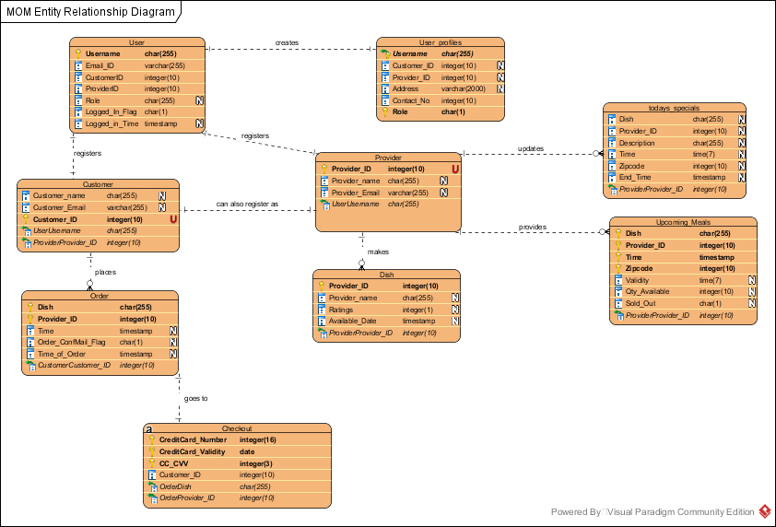
Database Schema
16
2711 North First St. - San Jose, CA 95134 - www.itu.edu
*

Slide 17
Demo
http://mealsonmapmom.com.s3-website-us-west-1.amazonaws.com/MOM%20Homepage.html

Slide 18
Appendix
18
UML System Use Case Diagram
UML Sequence Diagrams (User, Customer, Provider)
Webpage Layout
Product Screenshots
Test case Document
Meals On Map Capstone Document
2711 North First St. - San Jose, CA 95134 - www.itu.edu
*

Slide 19
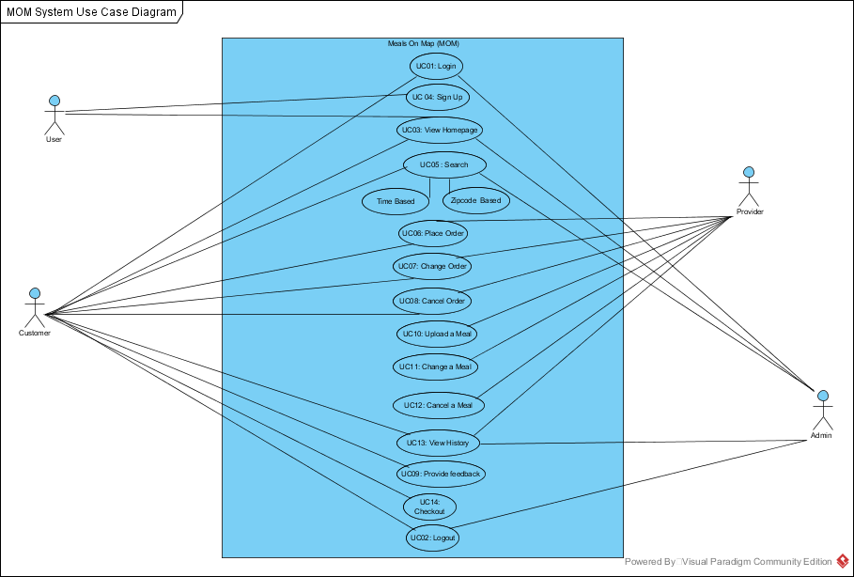
UML – System Use Case Diagram
19
2711 North First St. - San Jose, CA 95134 - www.itu.edu
*

Slide 20
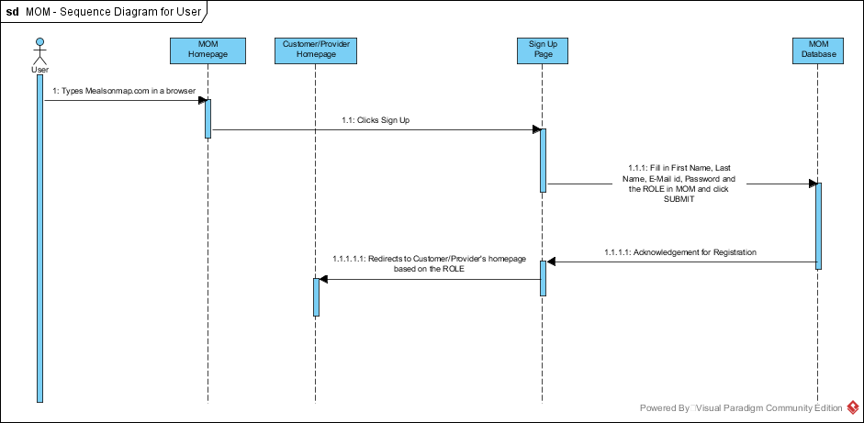
UML – Sequence Diagram
20
2711 North First St. - San Jose, CA 95134 - www.itu.edu
*

Slide 21
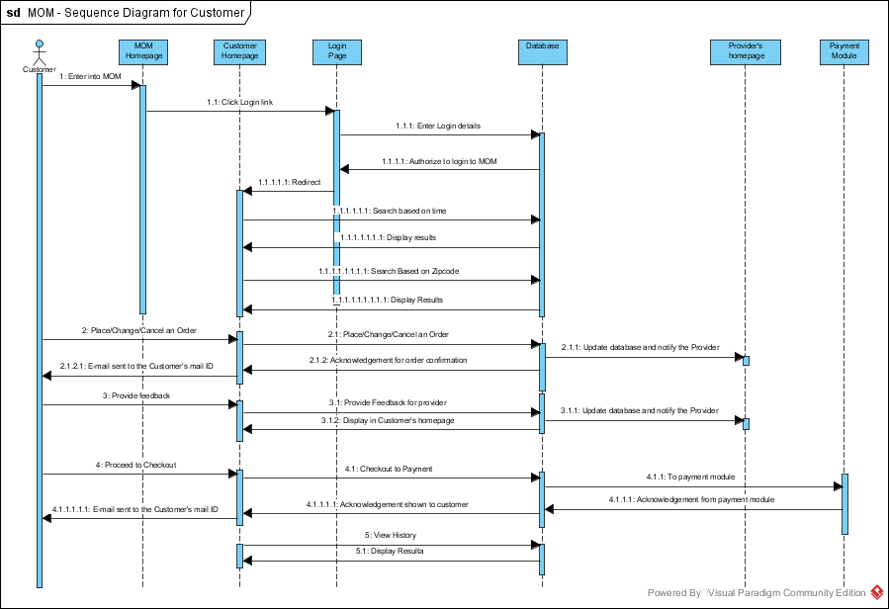
Customer - Sequence Diagram
21
2711 North First St. - San Jose, CA 95134 - www.itu.edu
*

Slide 22
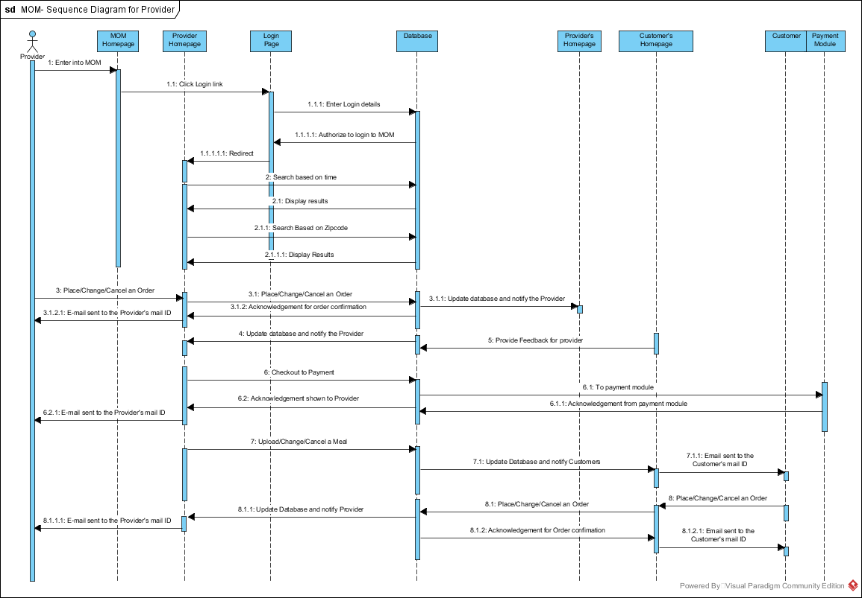
Provider – Sequence Diagram
22
2711 North First St. - San Jose, CA 95134 - www.itu.edu
*

Slide 23
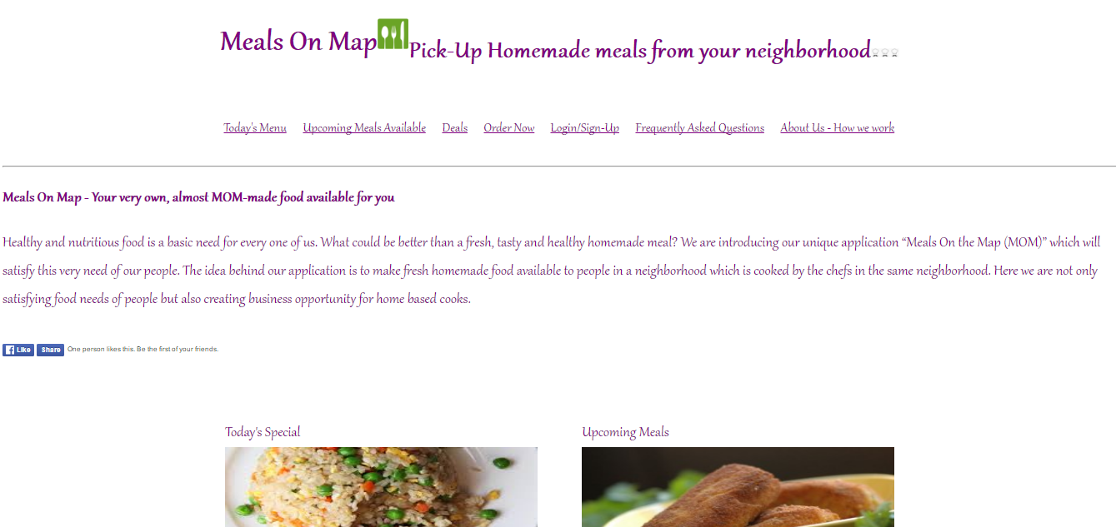
Product Screenshot 1

Slide 24
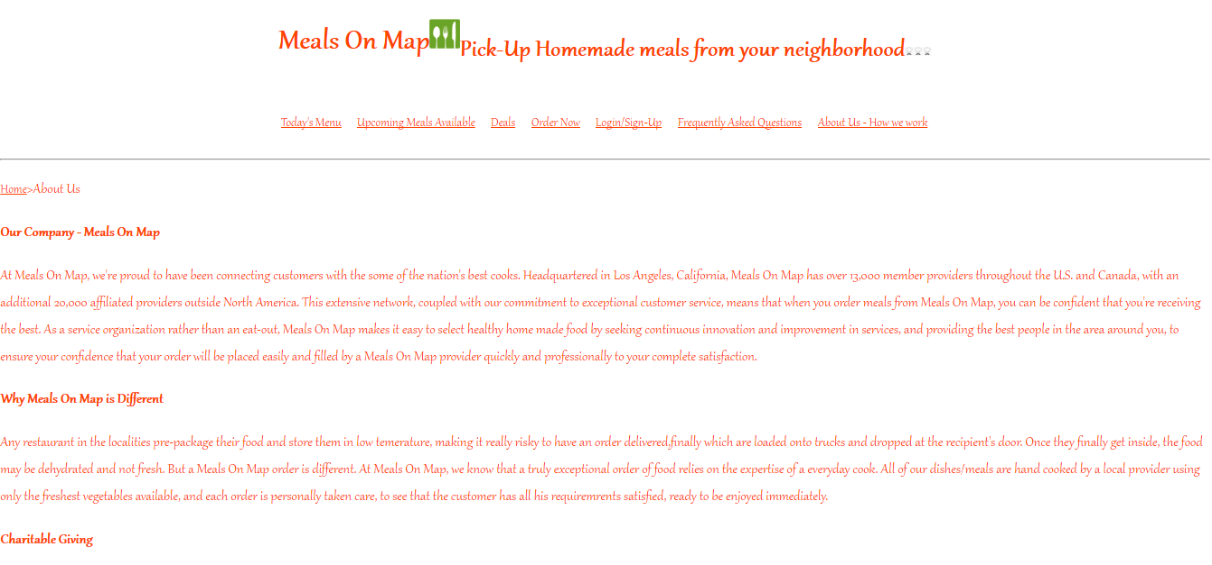
Product Screenshot 2

Slide 25
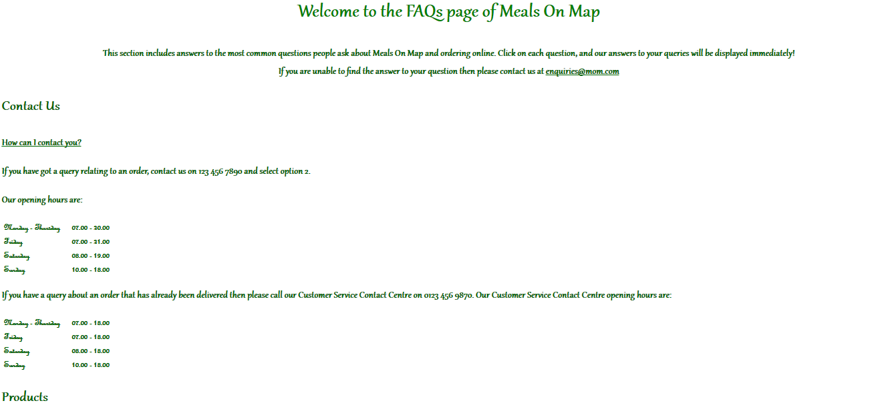
Product Screenshot 3

Slide 26
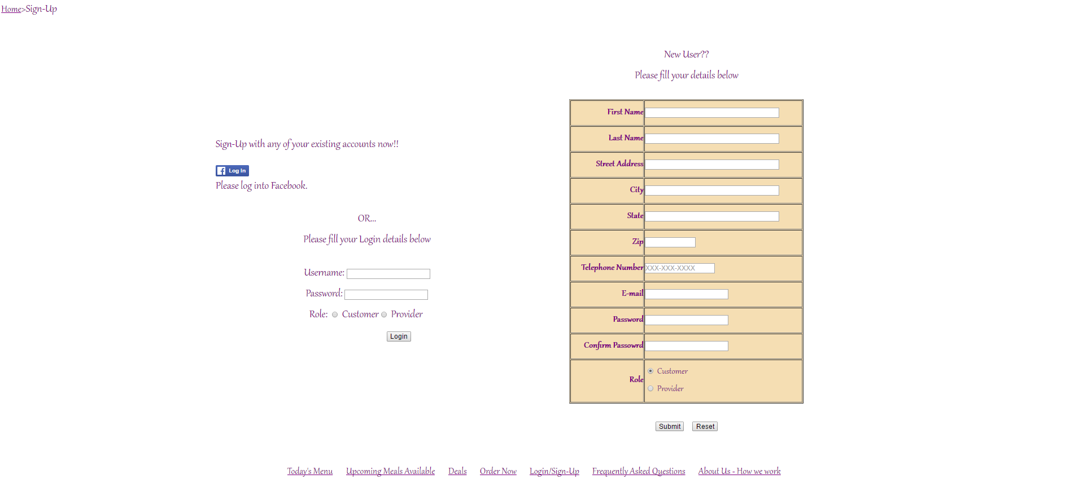
Product Screenshot 4

Slide 27
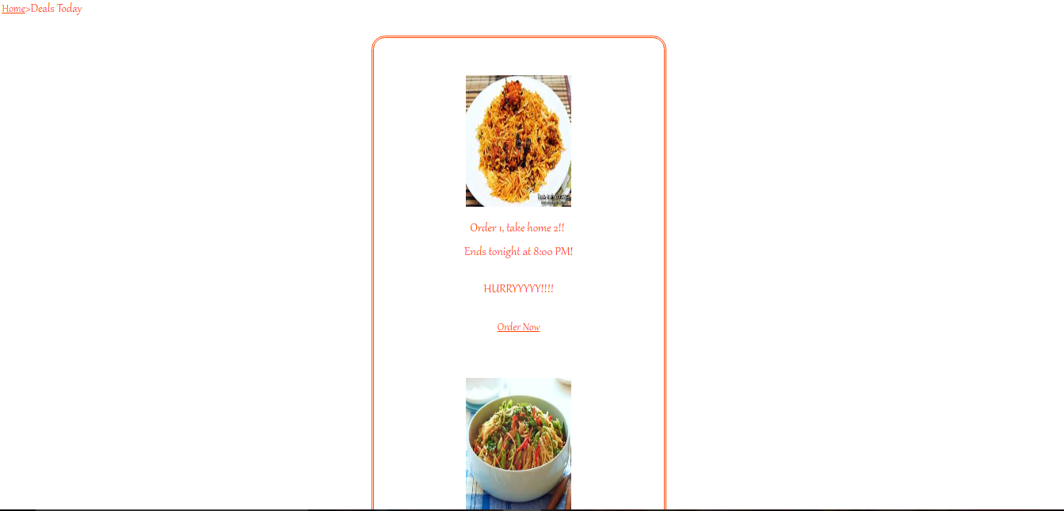
Product Screenshot 5

Slide 28
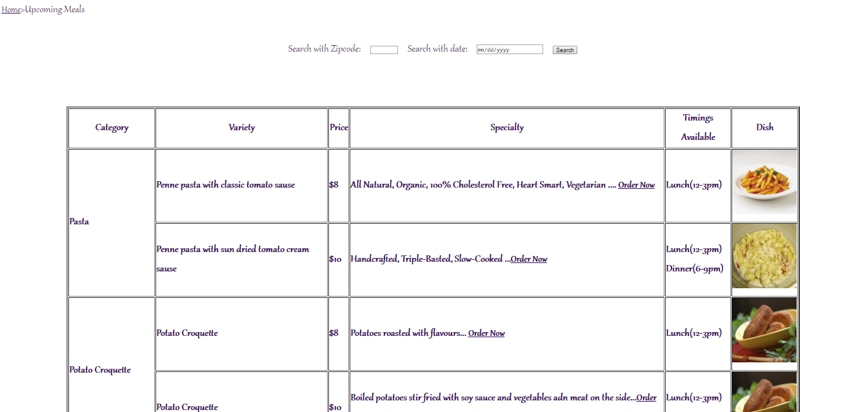
Product Screenshot 6

Slide 29

Quality Assurance

Slide 30
Documentation

Slide 31
Thank You!
We would be glad to answer any questions!

